Slide 1

Supply chain data set analysis

Slide 2
Explore data set
Key components of the supply chain data set include customers, products, orders, transportation providers, and locations. Each component plays a vital role in ensuring the timely and efficient movement of goods and services throughout the chain.
Our data set consist of 4 sheets : 1 fact table for orders and 3 dimention tables for customers,products and category.

Slide 3
Data cleaning
We have done many steps to clean and transform our dataset.
Drop columns (unnessary,empty)
Replace value.
Arrange colmns.
Change type.
Make relations between sheets.

Slide 4
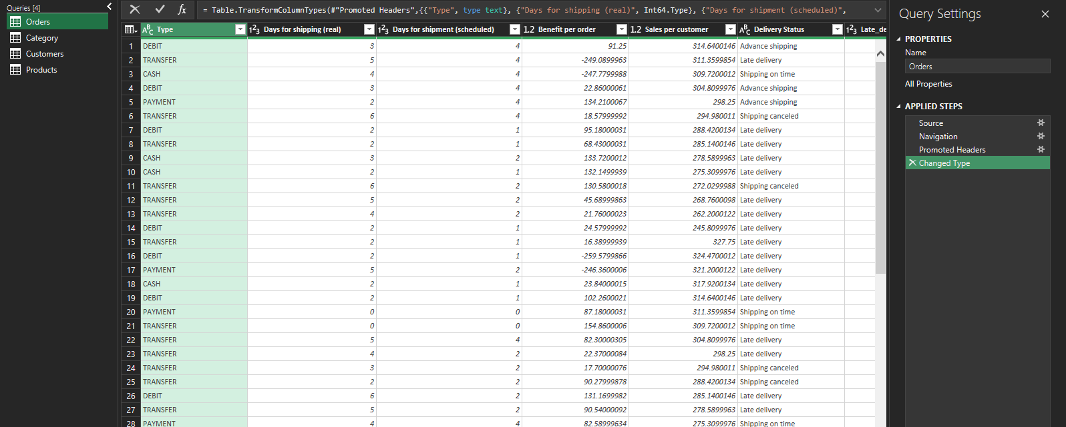
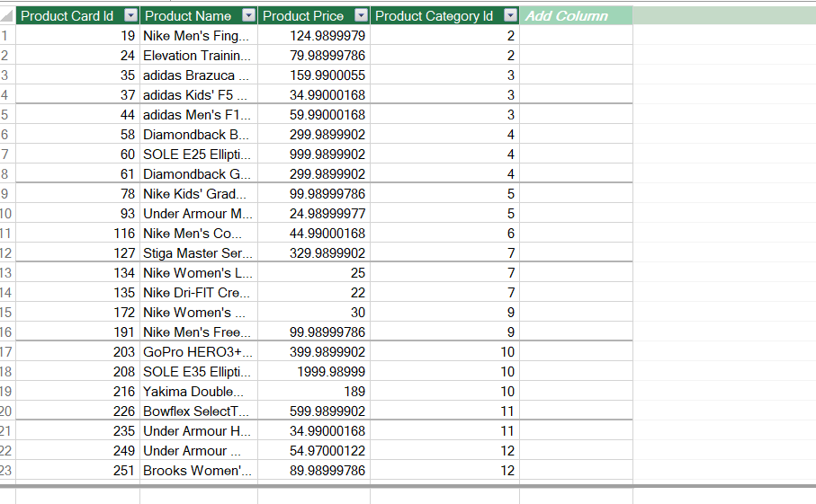
Drop columns and change type

Slide 5

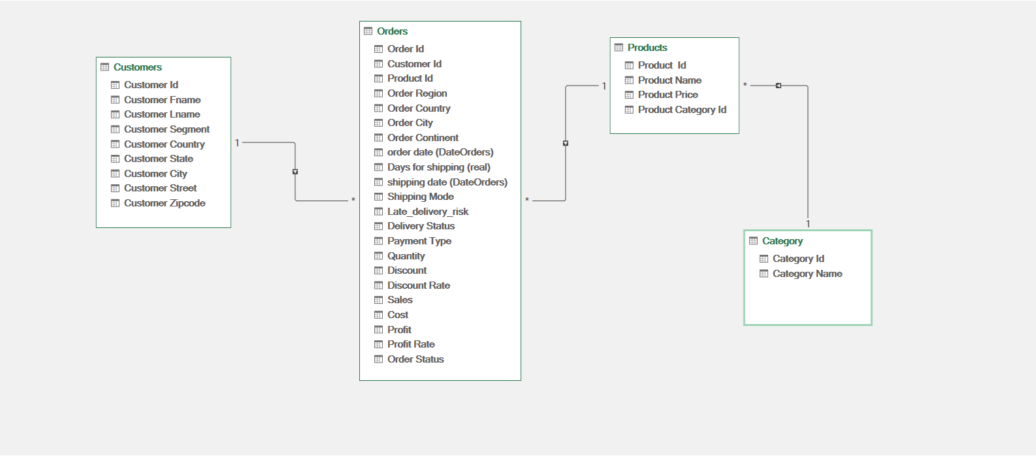
Make relations

Slide 6
Business questions.
We made pivot tables to answer key business questions and find kpis.
which is top 10 products in sales and profits?, and which is the bottom?.
Which is the most sold product?, and Is there a relation between the discount rate and quantity sold?
Which is top 5 countries in orders and what is the status of shipment?
What is the on time delivery rate for orders ?,and what is the order accuracy?

Slide 7
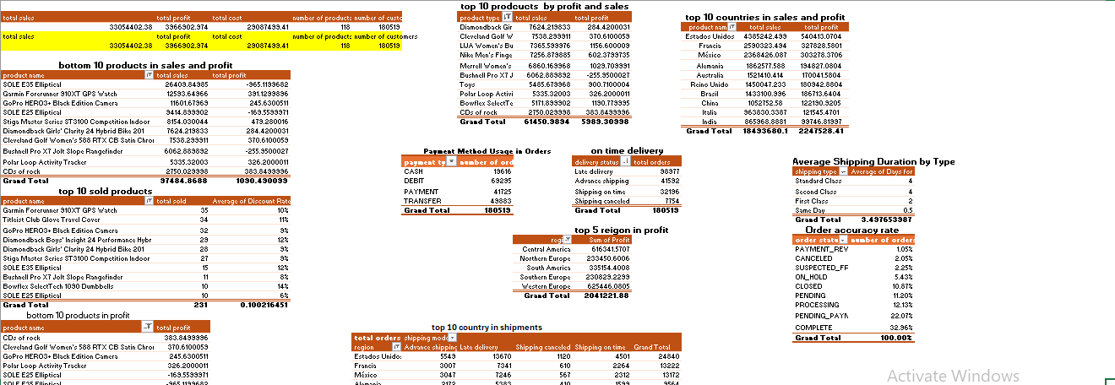
Pivot tables

Slide 8
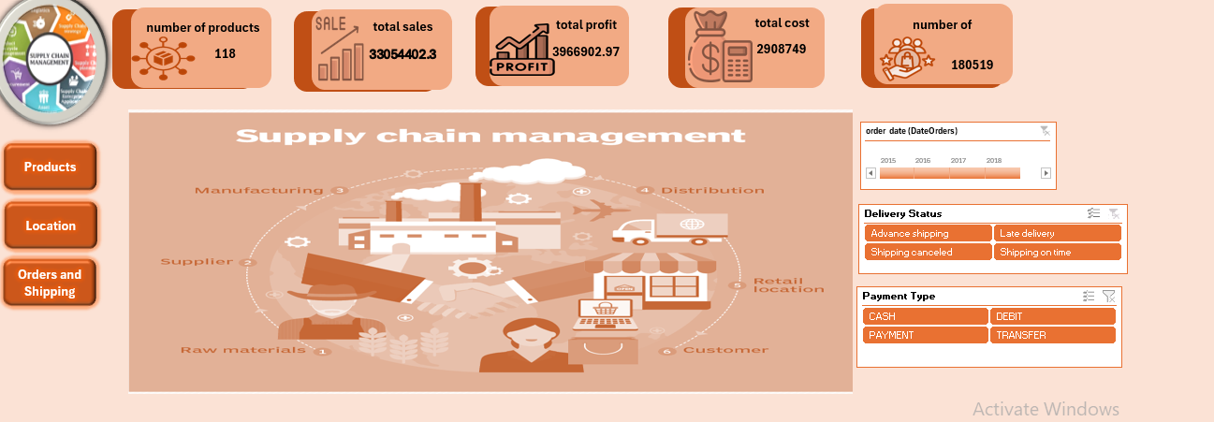
Home dashboard

Slide 9
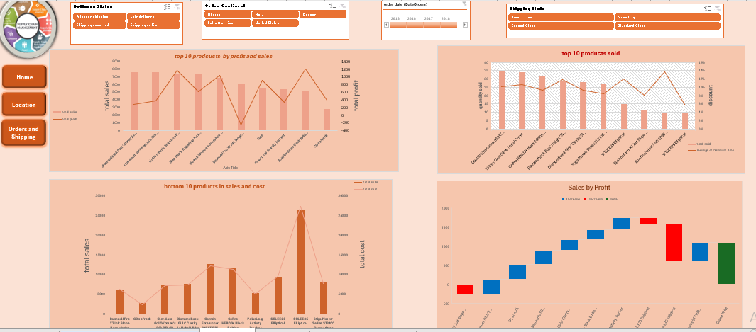
Insights: 1-the highest product in sales have a high profit. 2- the least product in sales have has a low difference between sales and cost. 3- the most sold product have a high discount rate.

Slide 10
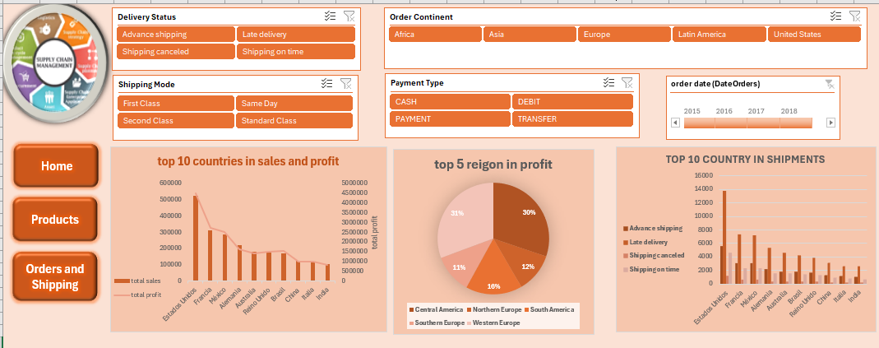
Insights: 1-the highest countries in sales have a high profit. 2- western Europe is the highest region in profit. 3-most shipments in the highest countries in orders is late delivery

Slide 11
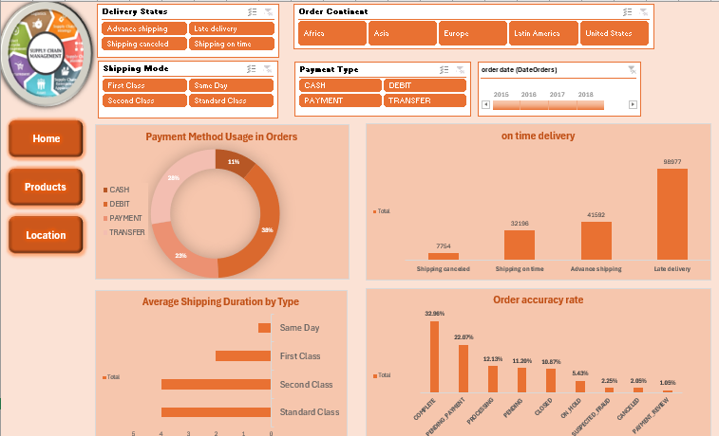
Insights: 1- most orders arrives late due to late delivery. 2- the most payment use in orders is debit card. 3- most orders is completed with out errors. 4- standard shipping is the slowest in time of delivery

Slide 12
Solutions to problems.
We suggest to put discount on the least product in sales or brand renewal for this products to increase the sales.
We suggest to make contracts with a better shipment company to increase the shipment in time rate.
We suggest that put discounts on products in the least countries in sales.

